Slide 1
Hades 2:
Sentiment Analysis
Orie Wyatt

Slide 2


Background Info
Developer: Supergiant Games
Hades Release Date: December 6, 2018
Hades 2 Release Date (EA): May 6, 2024
Genre: Roguelike, Hack and Slash

Slide 3


Gameplay
Hades
Hades II

Slide 4
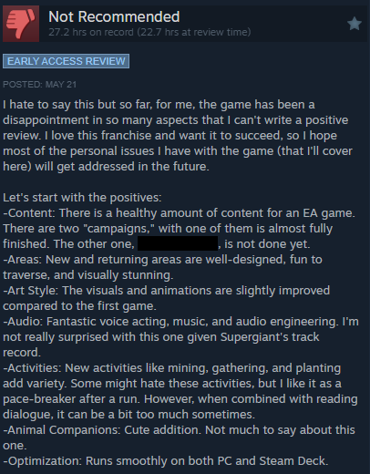
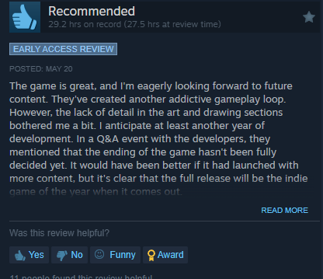
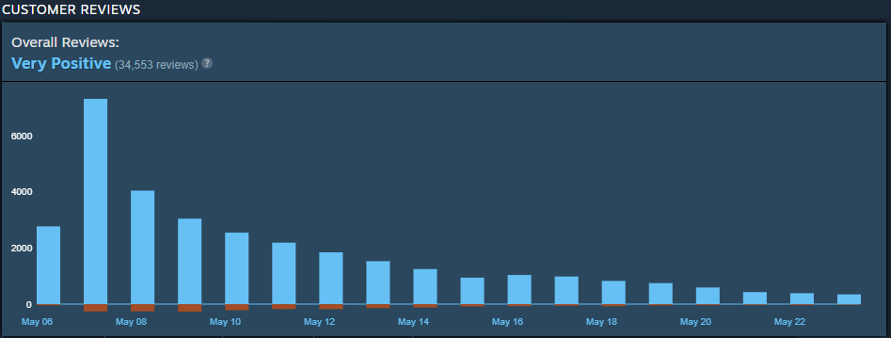
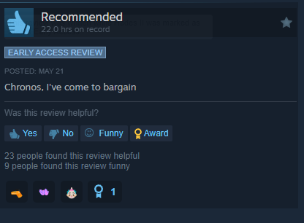
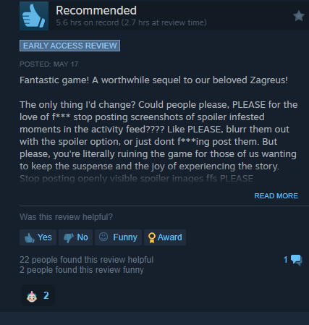
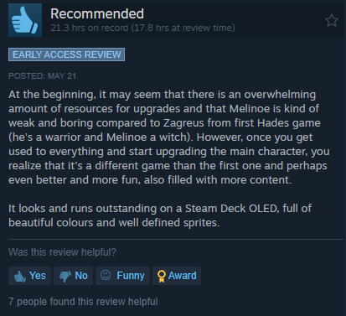
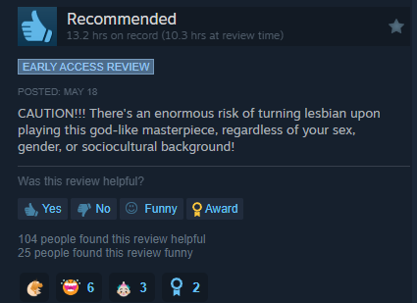
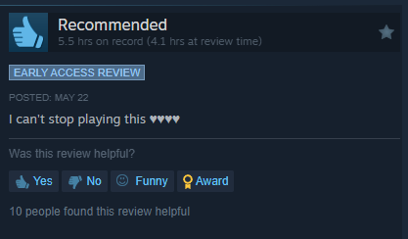
Reviews

Slide 5
Data Gathering
recommendationid - object
Author_steamid - object
author_num_games_owned - int64
Author_num_reviews - int64
Author_playtime_forever - int64
Author_playtime_last_two_weeks - int64
Author_last_played - int64
Review- object
Timestamp_created - int64
Timestamp_updated - int64
Voted_up - bool
Weighted_vote_score - object
Steam_purchase - bool
received_for_free - bool
Written_during_early_access - bool
Set up API through Steam’s
Set parameters to retrieve reviews
Get Hades 2 ID
Filter out foreign languages
Import as JSON
20880 reviews retrieved
Analyze reviews by:
Length
Hours played
Steam purchased

Slide 6
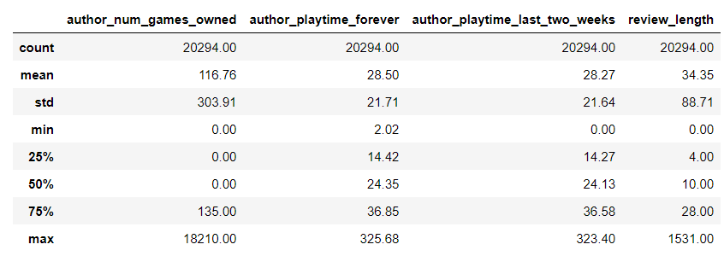
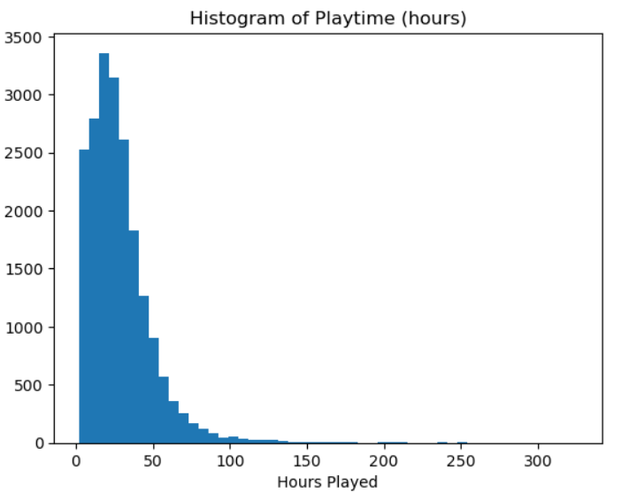
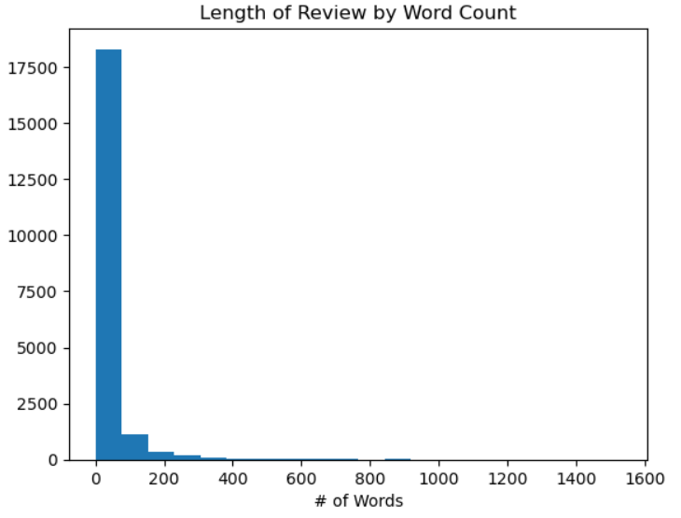
EDA
Many very brief reviews
Dropped reviews that were shorter than the 25% percentile
Keep reviews that were at least 5 words long
Dropped duplicate/spam reviews reviews:
“You can pet the frog” was repeated 30 times
Resulting DataFrame:
14291 reviews

Slide 7
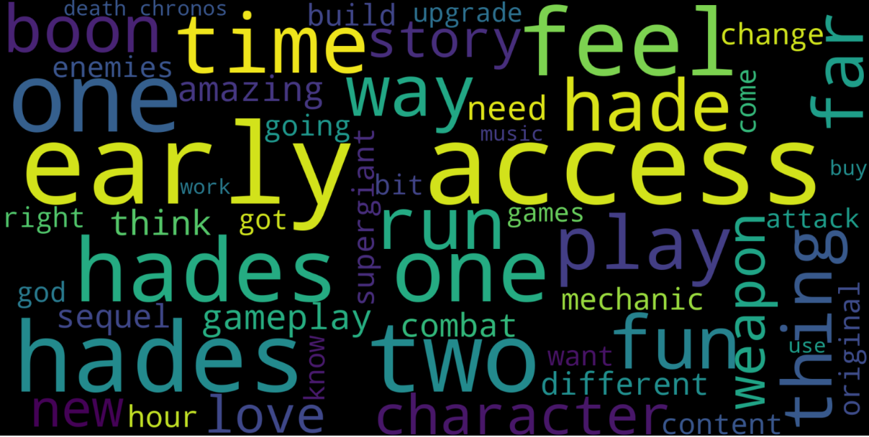
Text Cleaning
Remove contractions
Contra_dict.txt- predefined contraction list
Define and remove stopwords
Lowercase all text
Convert numbers to string version
Experiment with 2gram and 3grams
Build corpus (wordbank), dictionary for single words, 2 gram and 3 gram
Run through latent dirichlet allocation(LDA) model and review topics
Bigram word cloud

Slide 8
Perplexity and Coherence Scores
Aim for high coherence and low perplexity
Chose to continue with 2gram model as it has the highest coherence, with a slightly lower perplexity than single word model
Refined further to include 2grams containing nouns only
 | Single Word | 2gram | 3gram
Perplexity | -7.584416171 | -7.621682052 | -7.783620728
Coherence | 0.4510438224 | 0.4618914915 | 0.4360540116
 | 2gram- Noun
Perplexity | -7.584416171
Coherence | 0.6863804109

Slide 9
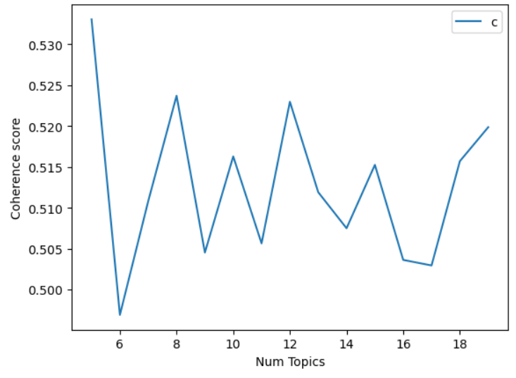
Topics
Graphed the coherence score by number of topics to decide on a number of topics to move forward.
Decided to move forward with 5 topics

Slide 10
Topics (cont.)
Sequel/Release Date: love hades_one _ early_access death_chronos content hour play time fun year day sequel supergiant release
Developer/Title: hade hades_two time early_access sequel supergiant_games liked_hades fan masterpiece supergiant banger title goty experience developer
Setting: character story gameplay combat way music mechanic weapon hades_one design art world boon style fun
Story: hade thing hades_one weapon fun story change way bit boon character mechanic early_access hades_two stuff
Gameplay: boon weapon enemy time attack boss dash thing damage way run use spoiler hades_one resource

Slide 11
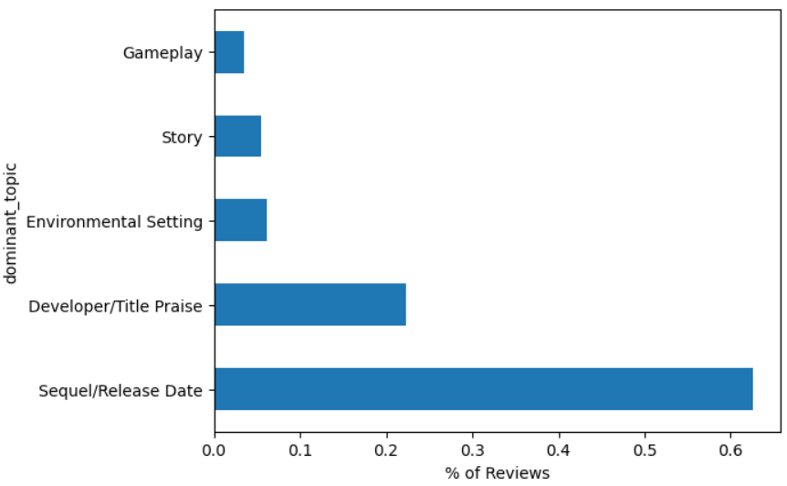
Topic Counts
Manually validated reviews by topics
Unsurprisingly, Hades 2 being a sequel is mentioned in many of the reviews

Slide 12
Token misclassification by number
400 review classifications were manually checked to validate classification
Relatively high misclassification rate
Did not seem to increase much based on # of tokens
Could be due to small sample size
# of Tokens | Correct | Wrong | Total | Misclassification Rate
0 | 36 | 24 | 60 | 0.4
1 | 73 | 46 | 119 | 0.3865546218
2 | 69 | 55 | 124 | 0.4435483871
3 | 60 | 36 | 96 | 0.375
4 | 0 | 0 | 0 | 0
5 | 0 | 0 | 0 | 0

Slide 13
Sentiment Analysis: Review Level
The accuracy of the sentiment analysis is slightly lower than what I had hoped
Gameplay seems anonymously low, likely due to early access nature, bugs, etc.
Tokens | % Positive | % Neutral | % Negative
Sequel/ Release Date | 60.1 | 25.6 | 14.3
Developer/ Title Release | 68.4 | 22.2 | 9.4
Environmental Setting | 71.5 | 18.3 | 10.2
Story | 74.6 | 14.2 | 11.1
Gameplay | 45.7 | 29.4 | 24.9

Slide 14
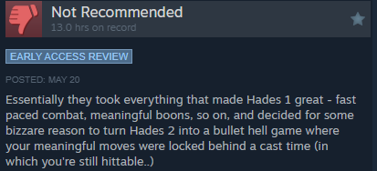
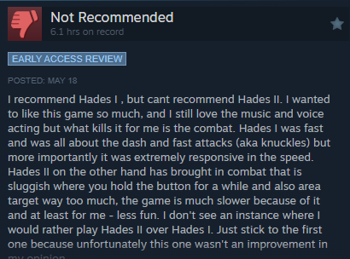
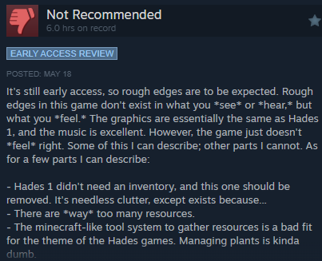
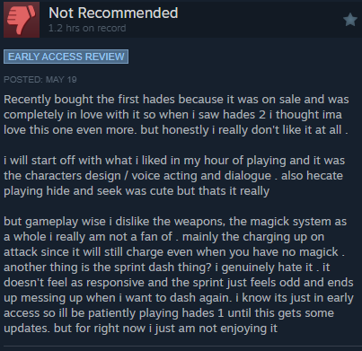
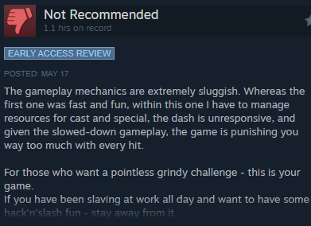
Negative Reviews

Slide 15
Future Work
Choose a different title decision:
Less trendy, more direct fanbase
Non-sequel
Spend more time receiving topics and review until the topics feel more concrete
Do a sentiment analysis involving only the negative reviews or helpful reviews
Follow Hades 2 to see if the issues presented by negative reviews are addressed/fixed

Slide 16
Sources
https://medium.com/@alfredtangsw/steamvox-topic-modelling-sentiment-analysis-technical-adc5b88f71a0
https://github.com/woctezuma/download-steam-reviews/tree/master/steamreviews
https://store.steampowered.com/app/1145350/Hades_II/
https://store.steampowered.com/app/1145360/Hades/

